Slide 1

Student learning habit in COVID-19
DATA VISUALIZATION
TEAM 1

Slide 2

Contents
1
Introduction
Snowball sampling method.
Dataset overview.
2
Visualization & Statistics
Student learning habit trending.
Which approach is used to teach and learn?
3
Conclusion
Advantages & Disadvantages

Slide 3
INTRODUCTION
Why we change learning method from offline to online?
Which research goals should be concerned?

Slide 4

Introduction
Data collect
23/1/2020
7/2
9/2
28/2
16/3
Now
The pandemic started in Vietnam
First school closure

Slide 5
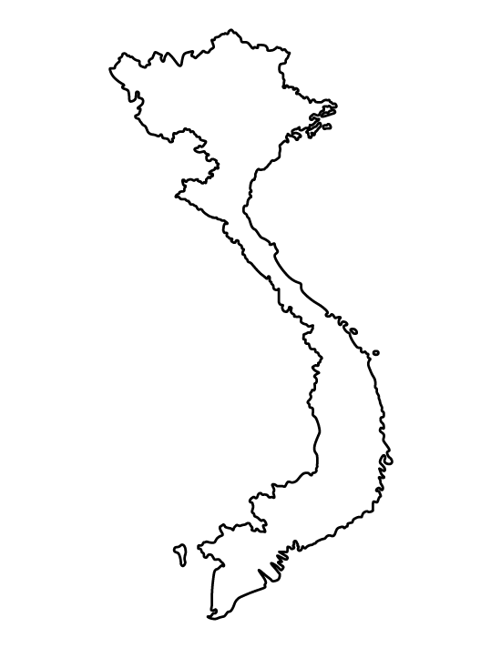
Introduction
Hà Nội
1556 schools
1.4M students

Slide 6



Introduction
Data Analysis
Parents
Target

Slide 7
Question survey
1
Student demographics
2
Student habit of study
3
Student academic competencies, necessities and effectiveness.

Slide 8
Introduction
The dataset has 420 valid responses with total 40 features.
1
Nominal data (6 features)
2
Ordinal data (25 features)
3
Numerical data (9 features)

Slide 9


Introduction
Data source
https://data.mendeley.com/datasets/2pzvmnb2km/4

Slide 10
VISUALIZATION & STATISTICS
Which factors affect to learning habit?
Do have students changed learning habit since the pandemic began?

Slide 11
Learning habit analysis
What factors affect to learning hours in home?
Gender
Self-learning
Class
School type
Online learning
Income
Offline learning
English level
Other …

Slide 12
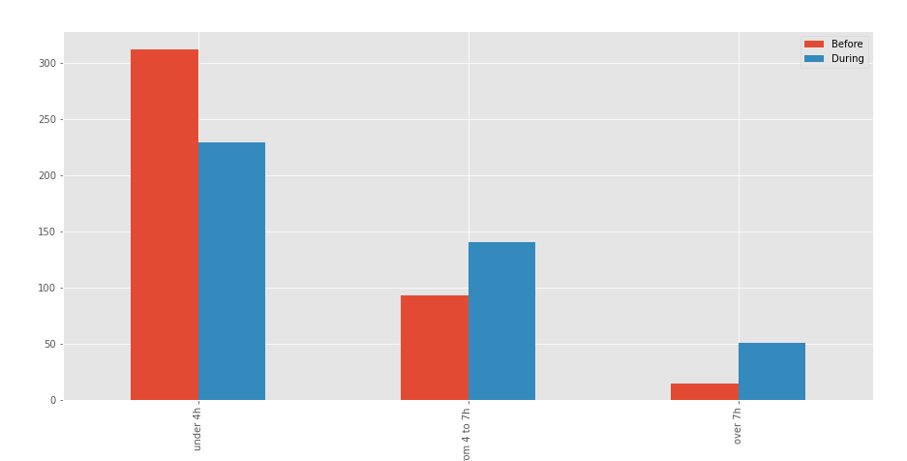
Learning habit trending
 | Before | During
Under 4h | 74.29% | 66.03%
From 4 to 7h | 22.14% | 30.03%
Over 7h | 3.57% | 3.85%
Do have students changed self-learning habit when the pandemic began?
38.3% observation have changed learning habit
33.8 – 43.1% students have changed learning habit

Slide 13




Learning habit trending
Under 4h
77.73% observations learn at public schools
55.9% observations have good grades
48.74% observation prepare to examine D (Literature, Foreign language, Mathematics)
Over 50% observations have income less than 860$

Slide 14
Learning habit trending
From 4 to 7h
27.86% observations learn at private schools
65% observations have good grades
Observations prepare to examine D (35.71%) and A1(24.29%)
75% observations have income larger than 860$

Slide 15
Learning habit trending
Over 7h
Almost observations learn at public and private schools. Only this groups include international school (low rate)
Over 25% observations have excellence grade.
Observations prepare to examine D (50.98%) and A1(19.61%)
29.41% observations have income from 860 to 1290$

Slide 16

Learning habit analysis
On average, each student has spent to learn from the pandemic began.
Online
2.43 – 3.04 hours
Offline
2.67 – 3.2 hours

Slide 17

Different learning hours between gender
Online
Offline
2.6
2.9
2.77
3.0
There is no difference in learning hours between gender.
1
Female observation learning more than male 1 hours when have no instruction
2
Male observation learning more than female 1 hours when have instruction
3

Slide 18
Different learning hours between gender
There is no difference in learning hours between gender.
1
Hypothesis testing
p-value: 0.58
significance level: 0.05
Average learning hours
Male: (2.49, 3.1)
Female: (2.34, 2.92)

Slide 19
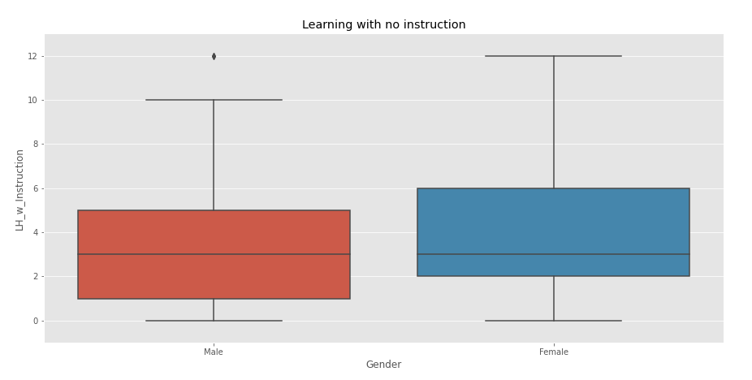
Different learning hours between gender
Female student learning more than male 1 hours when have instruction
2

Slide 20
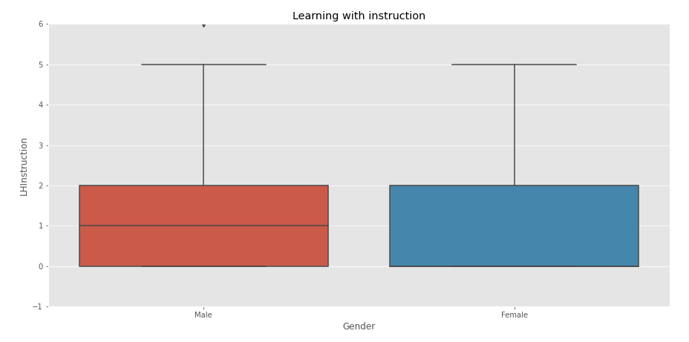
Different learning hours between gender
Male observation learning more than male 1 hours when have instruction
3

Slide 21
Different learning hours between school type
3.6
1
Private school have learning hours larger than public school (gifted)
p-value: 0.02
significance level: 0.05
3
2.7
2.3
2
2
2
Range time for each school
1
Public school (normal): 2.1 – 2.58
Public school (gifted): 2.38 – 2.96
Private school: 3.3 – 4.03
International school: 1.72 – 2.28
0
Public school (normal)
Public school (gifted)
Private school
International school

Slide 22
Different learning hours between grade level
1
Secondary student in Vietnam learn more than Japan.
Vietnam
Japan
p-value: 6e-4
significance level: 0.05
3
2.9
2.5
2.5
2.2
2
Which percent of number students learn with time larger than 3 hours?
2
1
26 – 38% secondary student learn with time larger than 3 hours.
0
Secondary school
High school

Slide 23
Linear regression on learning habit model
Model | R-Square | Adjust R-square | F statistics
Total online ~ School type + Income + English | 0.435 | 0.431 | 1.82e-57
Total online ~ School type + Income + English + Gender | 0.439 | 0.434 | 4.75e-51
Total online ~ School type + Income + English + Total offline | 0.539 | 0.534 | 1.26e-67
Total online ~ School type + Income + English + Total offline ^ 2 | 0.55 | 0.546 | 7.72e-71
Baseline model for linear regression

Slide 24
Linear regression on learning habit model
 | coef | p-value
school_type | 0.328 | 0.049
income | 0.146 | 0.162
English | 0.129 | 0.321
Total_offline | 0.47 | 0.000
 | coef | p-value
school_type | 0.4564 | 0.049
income | 0.1375 | 0.162
English | 0.3141 | 0.321
Total_offline_2 | 0.0371 | 0.000
Model 3
Model 4

Slide 25
Linear regression on learning habit model
Model 5: Total online ~ School_type + Total_offline
 | coef | p-value
school_type | 0.65 | 0.000
Total_offline | 0.5 | 0.000
Model 6: Total online ~ School_type + Total_offline + Self_evaluation
 | coef | p-value
school_type | 0.4 | 0.000
Total_offline | 0.46 | 0.000
Self_evaluation | 0.24 | 0.031

Slide 26
CONCLUSION
Advantages & Disadvantages

Slide 27
Advantages
Instead using RGB color, the figures use base color with darker and lighter.
Explain relationship between dependent variables and predict variables.
Build a model to predict total online
Define which features are important to improve online learning hours.

Slide 28
Disadvantages
The data can exist bias because collect method
The model doesn’t useful to provide a solution for online learning

Slide 29
Question & Answer

Slide 30
Thank for listening

